Slide 1
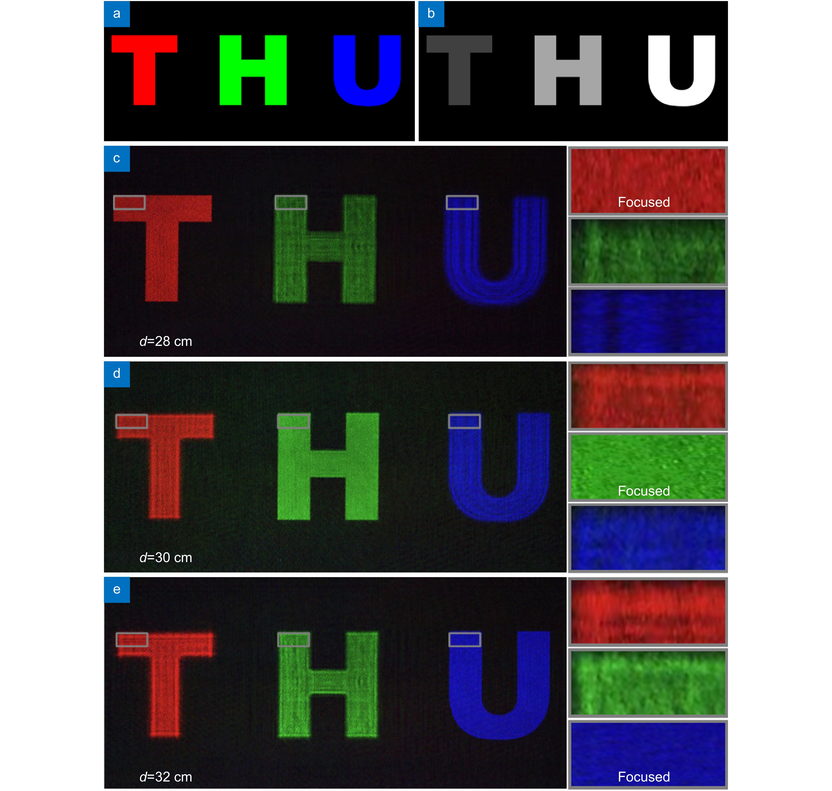
Figure 9. (a) All-in-focus image of the 3D scene. (b) Depth map of the 3D scene. (c) (d) and (e) Optical reconstructions of the 4K-DMDNet for 3D scene at the 28 cm, 30 cm and 32 cm, respectively. The enlarged views are presented at the right side.
Kexuan Liu,Jiachen Wu,Zehao He,Liangcai Cao
4K-DMDNet: diffraction model-driven network for 4K computer-generated holography
https://doi.org/10.29026/oea.2023.220135

